Slide 1
ASCSU ELECTIONS REMINDERS, UPDATES, AND NOTES
Emily Arnow, Elections Manager

Slide 2
AGENDA
1.
4.
2.
5.
3.
6.
INTRODUCTIONS
YOUR ROLE
Meet the team, roles
How you support engagement and turnout
WHY ELECTIONS
BIG CHANGES
Eligible positions, why you should care
What looks different this year?
REMINDERS
WHY DOES THIS YEAR MATTER
Key points going into the cycle
Trends, importance, goals

Slide 3
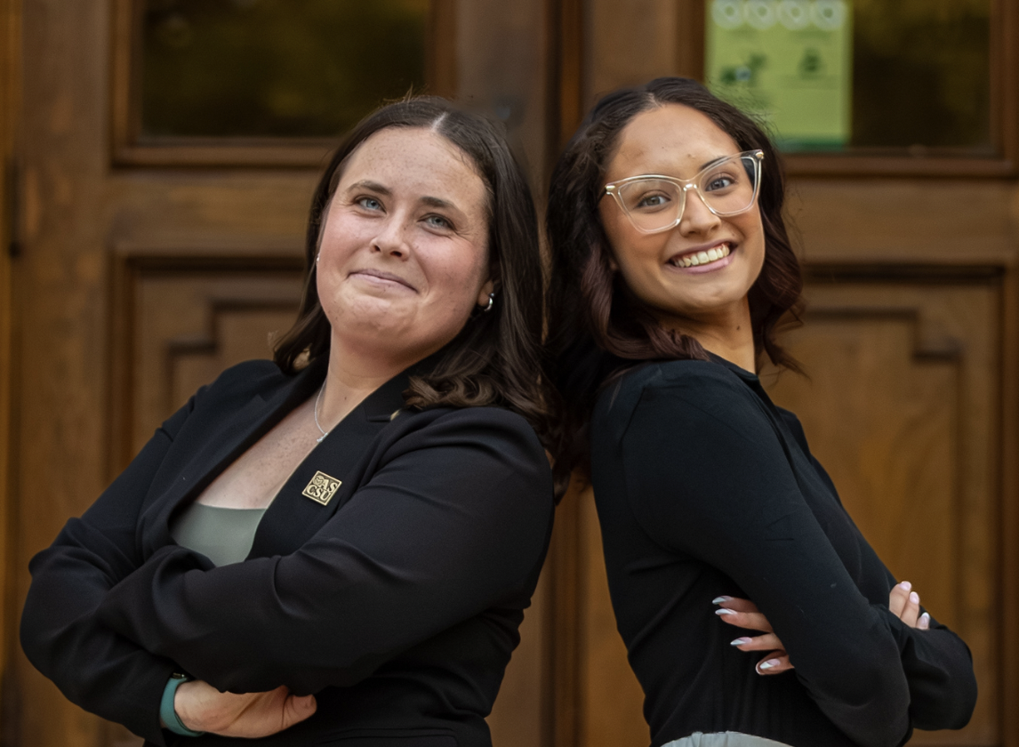
MEET THE ELECTIONS TEAM
EMILY ARNOW
CELINA MORA
Elections Manager
Elections Engagement Officer
Candidacy items
Violations + Hearings
Elections Committee
Voting
Outreach on:
  Voting
  Candidacy
  Etc.
Social media
Event planning

Slide 4
THE ELECTIONS TEAM, CONT.
Elections Committee
BENEDICTE KAMBA
BETH BALDWIN
EMMA SHAW
JOSIAH AVILA
KARA LISI
KARIS BLACKMAN
LAUREN DAVIS
LUKA SLOTEMAKER
MALLORY EISENREICH
NICOLE MORINE
NOAH EDDINGTON
SOPHIE NANNEMAN
GIOVANNI FALBO
Campaign liaisons
Violations hearings
Supporting outreach and engagement

Slide 5
OTHER ELECTIONS SUPPORT
MELANIE BROUSSEAU
PAMELA NORRIS
JULIA PRATT
ASCSU Advisor, Supporting Candidacy/Voting
ASCSU Advisor, Supporting Engagement
Chief Justice of ASCSU Supreme Court

Slide 6
WHAT’S ON THE BALLOT?
ELECTED ROLES
ASCSU CONSTITUTION
FOREVER GREEN T-SHIRT
President/Vice President
Speaker of the Senate
College Senators
Requires majority approval of 10% of ASCSU Members
Through Traditions department, shirt for first-year students

Slide 7
WHY DO ELECTIONS MATTER?
STUDENT REPRESENTATION
DEMONSTRATED ENGAGEMENT
ASCSU roles represent students, elections represent voices
Sitting on many boards/councils/etc., clear demonstration of true representation
CONSTITUTION RATIFICATION
DEMOCRATIC ENGAGEMENT
10% required, student support of Legislative work
Small-scale way for students to practice civic engagement

Slide 8
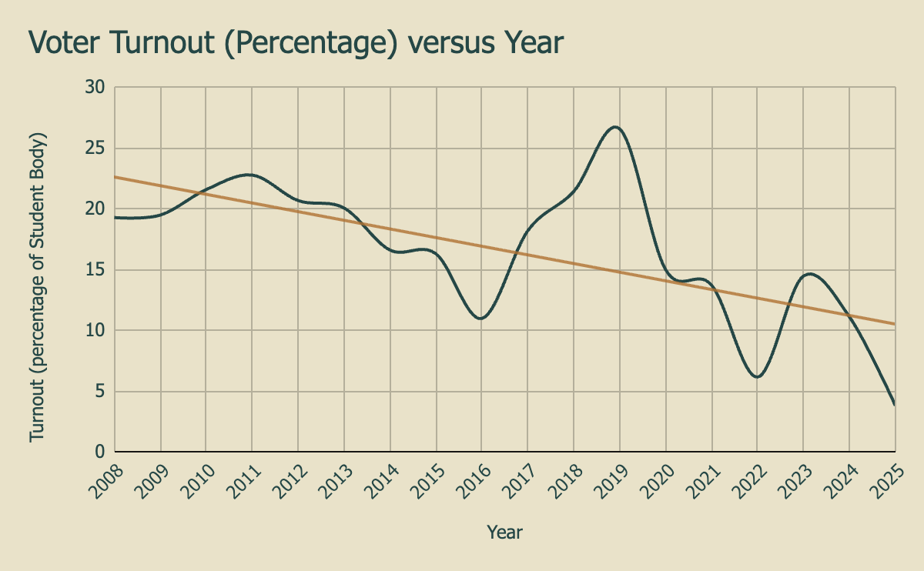
WHY IS THIS YEAR A BIG DEAL?
Turnout trends down overtime, student engagement is exceptionally low

Slide 9
GOALS FOR THE CYCLE
STUDENT ENGAGEMENT
CANDIDACY
OUTREACH
A broad candidate base supporting healthy competition
Growing and creating outreach opportunities to reach new student “bubbles”
Promoting participation through events, social media, and engagement efforts

Slide 10
YOUR ROLE
ENGAGING CONSTITUENTS
ATTENDING EVENTS
VOLUNTEERING TO TABLE
Contact your college/CRC, encourage engagement through all stages - we are happy to support!
Debate, candidate roundtable, rodeo event - bring a friend!
Large push during voting, sign-ups coming soon
This election will be successful with the support of everyone in ASCSU!

Slide 11
BIG CHANGES
SENATOR ORIENTATION
CODE EDITS
Now required, 4x large group orientations scheduled, or 1:1 available
Many largely clerical edits - please review!
Timeline change!
COLLEGE COUNCIL ENGAGEMENT
Providing college council info to candidates, promoting communication early on
SOCIAL MEDIA CHANGES
TEAM ROSTER REQUIREMENT
ORIENTATION OVERHAUL
Significant overhaul of media policies, many new updates now covered
Submitted with D&E 1, promotes transparency and clearer hearings
New materials provided, setting candidates up for success, accessibility prioritized

Slide 12
KEY REMINDERS
Act with respect, honesty, and fairness throughout the process
Conduct yourself and act in a way you will be proud of
No office talk at any point regarding campaigns
No campaigning before campaigning period begins (8:00 AM on 2/23/26)

Slide 13
CONCERNS/QUESTIONS
PROCESS QUESTIONS
CODE ADHERENCE
Stop by judicial/elections office hours, email me, reach out!
Submit Violations Form under Elections tab of website - reach out if unsure!
While this is not a violations game, you have a role to hold candidates accountable.

Slide 14
Questions?
Reach out to ascsu_elections@mail.colostate.edu
Follow our Instagram @ascsuelections

